Slide 1
Neurologic Disorder
Dr. Husham Aldaoseri
18/Oct/2023

Slide 2
Overview of Anatomy and Physiology
Structural divisions – 2 main
Central nervous system (CNS)
Brain and spinal cord
Peripheral nervous system – 2 main
Somatic nervous system
Sends messages from the CNS to the skeletal muscles; voluntary
Autonomic nervous system
Sends messages from the CNS to the smooth muscle, cardiac muscle, and certain glands; involuntary

Slide 3
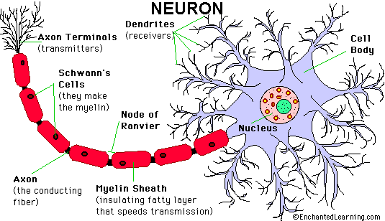
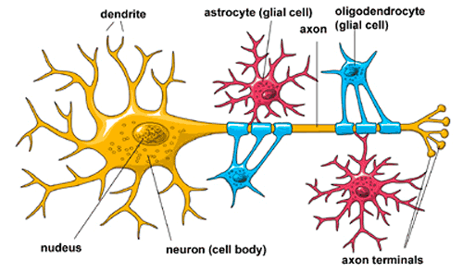
Cells of the nervous system – 2 broad categories
Category one:
neurons – transmitter cells
Space between each
neuron is called a synapse
Category two:
neuroglial or glial cells – support cells

Slide 4
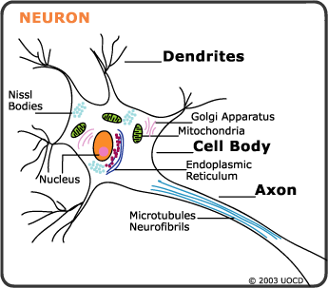
Neuron (nerve cell) : 3 Main structures
Cell Body: contains a nucleus surrounded by
cytoplasm
Axon: cylindric extension of the nerve cell
that conducts impulses away from the
neuron cell body
Dendrites: branching structures that extend
from a cell body and receive impulses

Slide 5
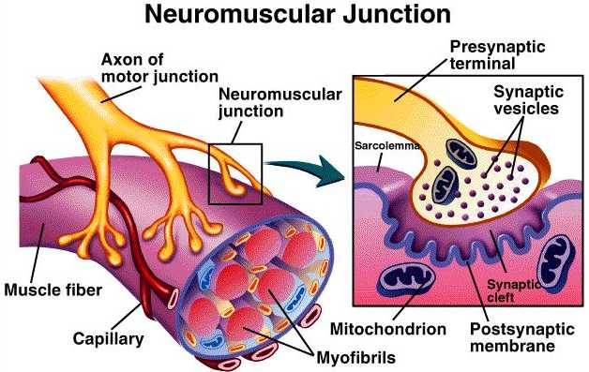
Neuromuscular junction: is the area of contact between the ends of a large myelinated nerve fiber and a fiber of skeletal muscle. The neurotransmitters act to make sure that the neurological impulse passes from the nerve to the muscle.

Slide 6
Neurotransmitters: chemicals that modify or result in the transmission of impulses between synapses
Acetylcholine: role in nerve impulse transmission; spills into the synapses area and speeds up transmission of the impulse. Enzyme cholinesterase is then released to deactivate the acetylcholine once the message or impulse has been sent.
Norepinephrine: has an effect on maintaining arousal (awakening from a deep sleep), dreaming, and regulation of mood (happiness or sadness).

Slide 7
Neurotransmitters: cont.
Dopamine: affects motor function (gross subconscious movements of the skeletal muscles), also plays a role in emotional response. Parkinson’s disease there is a decrease in dopamine levels. This causes the tremors, or involuntary, trembling muscles
Serotonin: induces sleep, affects sensory perception, controls temperature, and helps regulate mood

Slide 8
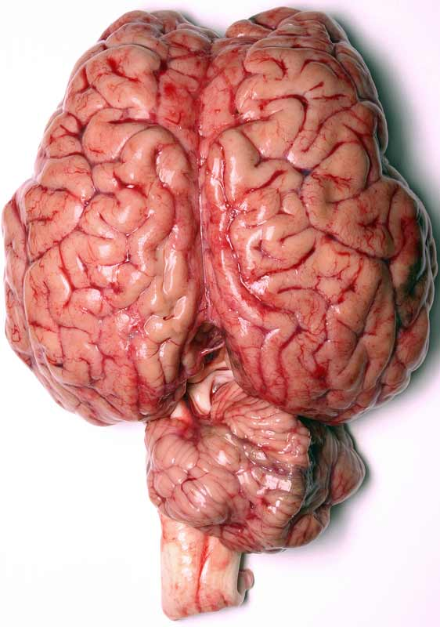
Central nervous system: One of two main divisions of the nervous system and composed of the brain and spinal cord. Cranium protects the brain. Vertebral column protects the spinal cord
Brain: specialized cells in the brain’s
mass of convoluted, soft, gray or white
tissue coordinate and regulate the
functions of the CNS. One of largest
organs weighing approximately 6.6 kg. Divided
into 4 principal parts: the cerebrum, diencephalon,
cerebellum, and the brainstem.

Slide 9
Common Disorders of the Neurological System
Vascular headaches
Migraine
Pre-Migraine aura: visual field defects, unusual smells or sounds, disorientation, paresthesias
During Migraine: nausea, vomiting, sensitivity to light, chills, fatigue, irritability.
Cause includes abnormal metabolism of serotonin, a vasoactive neurotransmitter found in platelets and cells of the brain, plays a major role.

Slide 10
Cluster
Aka alarm clock headache : known to wake up patients in the middle of the night with intense pain in or around the eye on one side of your head
Pain is described as sharp, penetrating or burning.
A cluster period generally lasts from six to 12 weeks
Risk factors include: Gender (men) Age (late 20’s) Smoking/Alcohol use, family history
Tension headaches – caused by tension, stress, or cervical arthritis

Slide 11
Medical management/nursing interventions
Pharmacological management
Migraine headaches
Aspirin, acetaminophen, ibuprofen
Ergotamine tartrate
Codeine; Inderal
Dietary recommendations
Limit MSG, vinegar, chocolate, yogurt, alcohol, fermented foods, ripened cheese, cured sandwich meat, caffeine.
Psychotherapy

Slide 12
Medical management/nursing interventions
Cluster headaches
Narcotic analgesics
Tension headaches
Non-narcotic analgesics

Slide 13
Epilepsy
Etiology/pathophysiology
Transitory disturbance in consciousness or in motor, sensory, or autonomic function due to sudden, excessive, and disorderly discharges in the neurons of the brain; results in sudden, violent, involuntary contraction of a group of muscles
Incidence 50 per 100000 people
Types: partial, generalized, and unclassified seizures
Status epilepticus

Slide 14
Q/Which of the following analgesics can cause epilepsy ?
A. Aspirin
B. Diclofenac sodium
C. Tramadol
D. Nimusilide

Slide 15
Clinical manifestations/assessment
Depends on type of seizure
Aura
Postictal period
Medical management/nursing interventions
During seizure: Protect from aspiration and injury
Anticonvulsant medications

Slide 16
Medical management/nursing interventions (continued)
Adequate rest
Good nutrition
Avoid alcohol
Avoid driving, operating machinery, and swimming until seizures are controlled
Good oral hygiene

Slide 17
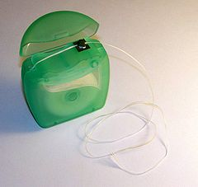
Oral health consideration
Patient with poorly or uncontrolled seizure may not suited for private dental offices.
Use of dental floss to minimize the risk of injury and aspiration during dental treatment
Anticonvulsant medications can cause bone marrow suppression.
Aspirin and NSAIDs avoided postoperative in patient take valproic acid increase possibility of bleeding
Gingival overgrowth 50% phentyoin
Xerostomia .

Slide 18
Stroke (cerebrovascular accident [CVA])
Etiology/pathophysiology: Blood flow to a part of the brain stops. Aka.. Brain attack
Abnormal condition of the blood vessels of the brain: 2 types
85% thrombosis & embolism = ischemic stroke
15% hemorrhage = hemorrhagic stroke (weak and bursts open, aneurysm, arteriovenous malformation)
Results in ischemia of the brain tissue
Most common disease of nervous system (estimated 700,000 suffer strokes each yr. and the cause of 158,000 deaths annually)
All ages affected

Slide 19
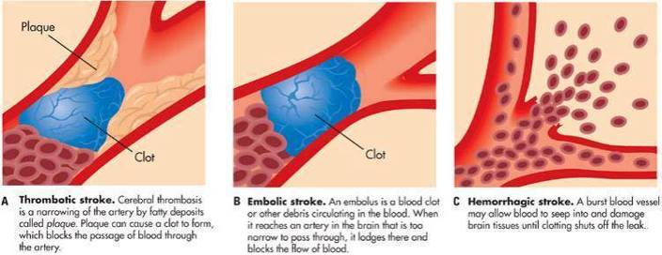
Three types of stroke

Slide 20
Q/Reversible ischaemic neurological deficit (RIND) usually recovers within:
A. 24 hours
B. 96 hours
C. 2 weeks
D.3 weeks

Slide 21
Stroke (cerebrovascular accident [CVA]) cont.
Risk Factors
Atrial Fibrillation
Diabetes
Family Hx of stroke
High Cholesterol
Increasing age >65
Race (black people are more likely to die of a stroke)
Unhealthy lifestyle
Overweight or obese
Drinking heavily
To much fat or salt in diet
Smoking
Illegal drugs (cocaine)
Birth control pills

Slide 22
Stroke (cerebrovascular accident [CVA]) cont.
Clinical manifestations/assessment
Headache
Sensory deficit
Hemiparesis; hemiplegia
Dysphasia or aphasia
Diagnostics
CT – primary test for diagnosis. Used to differentiate between ischemic vs hemmorhagic
CT angiography (CTA) provides visualization of vasculature
MRI or PET used to determine extent of damage
Doppler, CTA, or MRA

Slide 23
Q/Commonest cause of aphasia is:
A. Hysteria
B. Cerebral infarction
C. Bram tumour
D. Cerebral haemorrhage

Slide 24
Oral health consideration
Used adjuvant oral hygiene technique and devices( oral antimicrobial rinse, oral irrigation, floss holders)
Prior history of stroke increased the risk of second stroke during 90 days
Drug interaction
Aspirin with NSAIDs
Warfarin with erythromycin, metronidazole and tetracycline.
Limited used of epinephrine-containing local anesthesia.
Stress reduction and confidence building

